Slide 1
UVa 11096 Nails

Slide 2
UVa 11096 Nails (Time Limit: 3 seconds)
牆壁上有一些釘子(以2維點座標表示),有一工人想拿一條橡皮筋(具原始長度)把這些釘子框起來,請問需要多長的橡皮筋長度,如果橡皮筋原始長度夠長,輸出橡皮筋原始長度;不然,輸出真正需求的長度.

Slide 3








UVa 11096 Nails
Example:
$$p_{6}$$
$$p_{3}$$
$$p_{4}$$
$$p_{2}$$
$$p_{5}$$
$$p_{7}$$
$$p_{1}$$
$$p_{0}$$

Slide 4
Sample Input
Sample Output
Test case #1
2
2 4
0 0
0 1
1 0
1 1
5 4
0 0
0 1
1 0
1 1
4.00000
5.00000
# of Test Cases
(Convex Hull的周長)
橡皮筋原始長度,點數
(橡皮筋原始長度)
Test case #2
Convex Hull的周長;若是比橡皮筋原始長度短,則輸出原始長度
點座標
y
Test case #1
(0,1)
1
Convex Hull的周長:4
比橡皮筋原始長度(2)長,
因此輸出4
(空一行)
(1,1)
1
1
x
(0,0)
1
(1,1)
y
Test case #2
(0,1)
1
Convex Hull的周長:4
比橡皮筋原始長度(5)短,
因此輸出5
(1,1)
1
1
x
(0,0)
1
(1,1)

Slide 5
Solution
Convex Hull
Graham’s scan
Time Complexity: O(n log n)

Slide 6








UVa 11096 Nails
要找圍住給定點最小面積的凸多邊形(即Convex Hull)
$$p_{6}$$
$$p_{3}$$
$$p_{4}$$
$$p_{2}$$
$$p_{5}$$
$$p_{7}$$
$$p_{1}$$
$$p_{0}$$
從P₀往Convex Hull頂點P₁,P₃,P₆,P₇極角由小到大

Slide 7




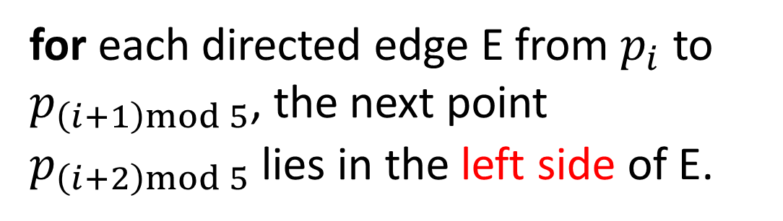
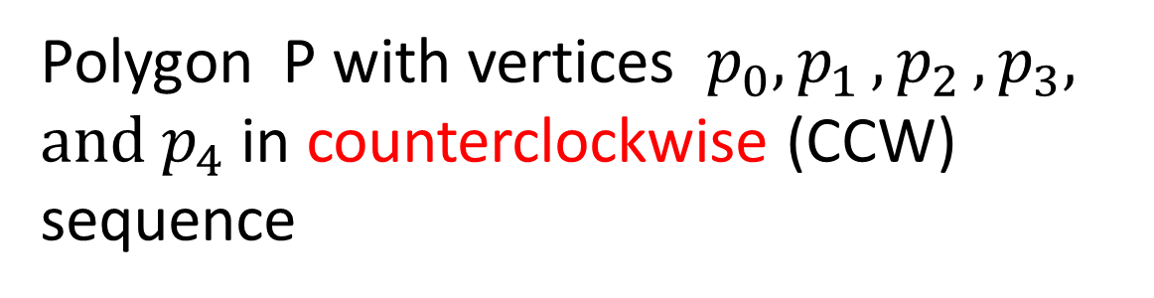

UVa 11096 Nails
Checking If a Polygon is Convex
Polygon P with vertices $p_{0}{, p}_{1}{, p}_{2}, p_{3}, {and p}_{4}$ in counterclockwise (CCW) sequence
$$p_{1}$$
$$p_{2}$$
Convex Condition:
P
$$p_{0}$$
for each directed edge E from $p_{i}$ to $p_{\left(i+1\right)mod 5}$, the next point $p_{\left(i+2\right)mod 5}$ lies in the left side of E.
$$p_{3}$$
$$p_{4}$$
If convex condition holds,
then polygon P is convex;

Slide 8

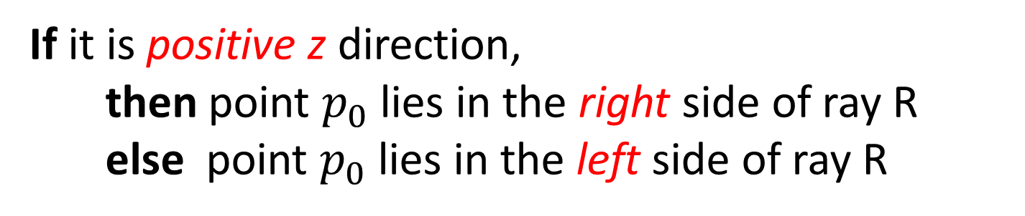
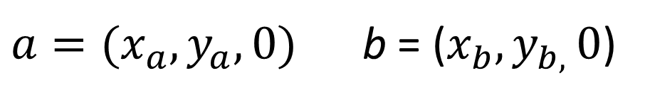

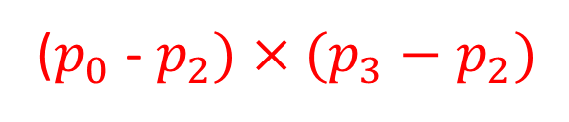

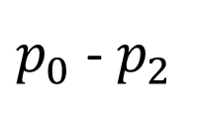


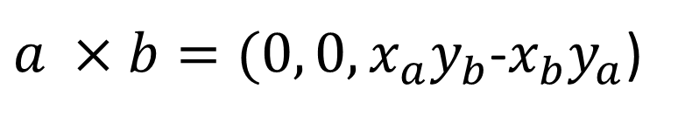
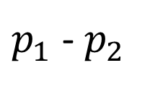
Left (or Right) Turn of a Ray
Ray R
$$p_{1}$$
$$p_{3}$$
Cross Product (2D Case)
$$p_{3}−p_{2}$$
$a=(x_{a}, y_{a}, 0)$ b = ($x_{b}, y_{b, }0$)
$p_{1}$ -${ p}_{2}$
⇒
$a ×b=(0, 0, x_{a}y_{b}$-$x_{b}y_{a}$)
$$p_{0}$$
$p_{0}$ -${ p}_{2}$
Examine the direction of
$$p_{2}$$
($p_{0}$ -${ p}_{2})×(p_{3}−p_{2})$
If it is positive z direction,
then point $p_{0}$ lies in the right side of ray R
else point $p_{0}$ lies in the left side of ray R

Slide 9
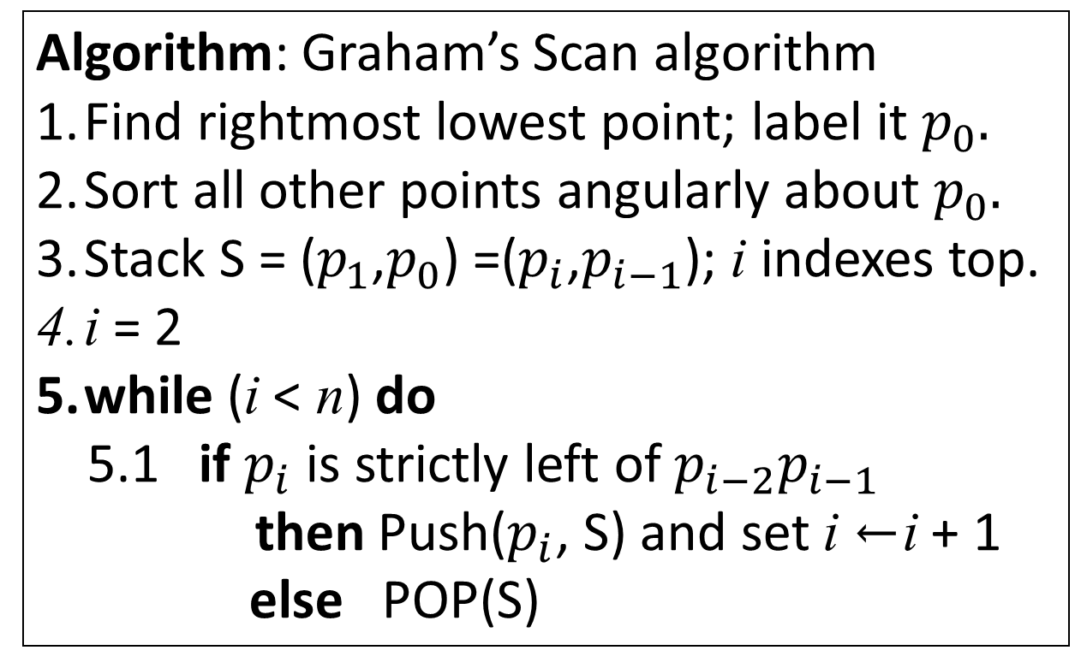
UVa 11096 Nails
Graham’s Scan Algorithm: an optimal convex hull algorithm
Algorithm: Graham’s Scan algorithm
Find rightmost lowest point; label it $p_{0}.$
Sort all other points angularly about $p_{0}.$
Stack S = ($p_{1}$,$p_{0}$) =($p_{i}$,$p_{i−1}$); i indexes top.
i = 2
while (i < n) do
5.1 if $p_{i}$ is strictly left of $p_{i−2}p_{i−1}$
then Push($p_{i}$, S) and set i ←i + 1
else POP(S)
Time Complexity: O(nlogn)

Slide 10
在做Graham’s scan之前,要找一點(最左, 最右, 最上或最下)作為極座標的原點
$$p_{6}$$
$$p_{3}$$
$$p_{4}$$
$$p_{2}$$
$$p_{5}$$
$$p_{7}$$
$$p_{1}$$
$$p_{0}$$

Slide 11


以最下面點p₀作為極座標的原點,將其它點依極角大小由小至大排序
p₂ 極角比p₁大, 則p₀,p₁,p₂形成逆時針, p₀,p₂,p₁形成順時針
$$p_{5}$$
$$p_{3}$$
$$p_{4}$$
$$p_{6}$$
$$p_{2}$$
$$p_{7}$$
$$p_{1}$$
$$p_{0}$$

Slide 12
UVa 11096 Nails
point
0 | 1 | 2 | 3 | 4 | 5 | 6 | 7 | 8
p0 | p1 | p2 | p3 | p4 | p5 | p6 | p7
Example 1 (Graham’s Scan)
$$p_{6}$$
$$p_{3}$$
$$p_{4}$$
$$p_{2}$$
$$p_{5}$$
$$p_{7}$$
$$p_{1}$$
$$p_{0}$$

Slide 13




UVa 11096 Nails
point
0 | 1 | 2 | 3 | 4 | 5 | 6 | 7 | 8
p0 | p1 | p2 | p3 | p4 | p5 | p6 | p7
$$∆$$
$$∆$$
$$∆$$
Example 1 (Graham’s Scan)
top-1
top
i
(左轉)
(加入p2點)
(支點)
point
0 | 1 | 2 | 3 | 4 | 5 | 6 | 7 | 8
p0 | p1 | p2 | p3 | p4 | p5 | p6 | p7
$$∆$$
$$p_{6}$$
top
$$p_{3}$$
i
$$p_{4}$$
top=2
$$p_{2}$$
$$p_{5}$$
$$p_{7}$$
$$p_{1}$$
top=1
$$p_{0}$$

Slide 14





UVa 11096 Nails
point
0 | 1 | 2 | 3 | 4 | 5 | 6 | 7 | 8
p0 | p1 | p2 | p3 | p4 | p5 | p6 | p7
$$∆$$
$$∆$$
$$∆$$
Example 1 (Graham’s Scan)
top-1
top
i
(右轉)
(p2點剔除,加入p3點)
)
(支點)
point
0 | 1 | 2 | 3 | 4 | 5 | 6 | 7 | 8
p0 | p1 | p3 | p3 | p4 | p5 | p6 | p7
top=2
$$∆$$
$$∆$$
$$p_{6}$$
top
i
$$p_{3}$$
$$p_{4}$$
top=2
$$p_{2}$$
$$p_{5}$$
$$p_{7}$$
$$p_{1}$$
$$p_{0}$$

Slide 15





UVa 11096 Nails
point
0 | 1 | 2 | 3 | 4 | 5 | 6 | 7 | 8
p0 | p1 | p3 | p3 | p4 | p5 | p6 | p7
$$∆$$
$$∆$$
$$∆$$
Example 1 (Graham’s Scan)
top-1
top
i
(左轉)
(支點)
(加入p4點)
point
0 | 1 | 2 | 3 | 4 | 5 | 6 | 7 | 8
p0 | p1 | p3 | p4 | p4 | p5 | p6 | p7
top=2
$$∆$$
$$∆$$
$$p_{6}$$
top
i
top=3
$$p_{3}$$
$$p_{4}$$
$$p_{2}$$
$$p_{5}$$
$$p_{7}$$
$$p_{1}$$
$$p_{0}$$

Slide 16





UVa 11096 Nails
point
0 | 1 | 2 | 3 | 4 | 5 | 6 | 7 | 8
p0 | p1 | p3 | p4 | p4 | p5 | p6 | p7
$$∆$$
$$∆$$
$$∆$$
Example 1 (Graham’s Scan)
top-1
top
i
(左轉)
(支點)
(加入p5點)
point
0 | 1 | 2 | 3 | 4 | 5 | 6 | 7 | 8
p0 | p1 | p3 | p4 | p5 | p5 | p6 | p7
$$∆$$
$$∆$$
$$p_{6}$$
top=3
top
i
$$p_{3}$$
$$p_{4}$$
top=4
$$p_{2}$$
$$p_{5}$$
$$p_{7}$$
$$p_{1}$$
$$p_{0}$$

Slide 17





UVa 11096 Nails
point
0 | 1 | 2 | 3 | 4 | 5 | 6 | 7 | 8
p0 | p1 | p3 | p4 | p5 | p5 | p6 | p7
$$∆$$
$$∆$$
$$∆$$
Example 1 (Graham’s Scan)
top-1
top
i
(右轉)
(支點)
(p5點剔除)
point
0 | 1 | 2 | 3 | 4 | 5 | 6 | 7 | 8
p0 | p1 | p3 | p4 | p5 | p5 | p6 | p7
$$∆$$
$$∆$$
$$p_{6}$$
top
i
top=3
$$p_{3}$$
$$p_{4}$$
top=4
$$p_{2}$$
$$p_{5}$$
$$p_{7}$$
$$p_{1}$$
$$p_{0}$$

Slide 18



UVa 11096 Nails
point
0 | 1 | 2 | 3 | 4 | 5 | 6 | 7 | 8
p0 | p1 | p3 | p4 | p5 | p5 | p6 | p7
$$∆$$
$$∆$$
$$∆$$
Example 1 (Graham’s Scan)
top-1
top
i
(右轉)
(支點)
(p4點剔除)
point
0 | 1 | 2 | 3 | 4 | 5 | 6 | 7 | 8
p0 | p1 | p3 | p4 | p5 | p5 | p6 | p7
top=2
$$∆$$
$$∆$$
$$p_{6}$$
top
i
top=3
$$p_{3}$$
$$p_{4}$$
$$p_{2}$$
$$p_{5}$$
$$p_{7}$$
$$p_{1}$$
$$p_{0}$$

Slide 19



UVa 11096 Nails
point
0 | 1 | 2 | 3 | 4 | 5 | 6 | 7 | 8
p0 | p1 | p3 | p4 | p5 | p5 | p6 | p7
$$∆$$
$$∆$$
$$∆$$
Example 1 (Graham’s Scan)
top-1
top
i
(左轉)
(支點)
(加入p6點)
point
0 | 1 | 2 | 3 | 4 | 5 | 6 | 7 | 8
p0 | p1 | p3 | p6 | p5 | p5 | p6 | p7
top=3
top=2
$$∆$$
$$∆$$
$$p_{6}$$
top
i
$$p_{3}$$
$$p_{4}$$
$$p_{2}$$
$$p_{5}$$
$$p_{7}$$
$$p_{1}$$
$$p_{0}$$

Slide 20





UVa 11096 Nails
point
0 | 1 | 2 | 3 | 4 | 5 | 6 | 7 | 8
p0 | p1 | p3 | p6 | p5 | p5 | p6 | p7
$$∆$$
$$∆$$
$$∆$$
(左轉)
Example 1 (Graham’s Scan)
top-1
top
i
(支點)
(加入p7點)
point
0 | 1 | 2 | 3 | 4 | 5 | 6 | 7 | 8
p0 | p1 | p3 | p6 | p7 | p5 | p6 | p7
top=3
$$∆$$
$$∆$$
$$p_{6}$$
top
i
$$p_{3}$$
$$p_{4}$$
$$p_{2}$$
$$p_{5}$$
top=4
$$p_{7}$$
$$p_{1}$$
$$p_{0}$$

Slide 21





UVa 11096 Nails
point
0 | 1 | 2 | 3 | 4 | 5 | 6 | 7 | 8
p0 | p1 | p3 | p6 | p7 | p5 | p6 | p7
$$∆$$
$$∆$$
$$∆$$
Example 1 (Graham’s Scan)
top-1
top
i
(支點)
(加入p0點)
point
0 | 1 | 2 | 3 | 4 | 5 | 6 | 7 | 8
p0 | p1 | p3 | p6 | p7 | p0 | p6 | p7
$$∆$$
$$∆$$
$$p_{6}$$
top
i
$$p_{3}$$
$$p_{4}$$
$$p_{2}$$
$$p_{5}$$
top=4
$$p_{7}$$
$$p_{1}$$
top=5
$$p_{0}$$

Slide 22
另外一個例子

Slide 23
UVa 11096 Nails
Example 2 (Graham’s Scan)
$$p_{5}$$
$$p_{3}$$
$$p_{4}$$
$$p_{6}$$
$$p_{2}$$
$$p_{7}$$
$$p_{1}$$
$$p_{0}$$

Slide 24
UVa 11096 Nails
Example 2 (Graham’s Scan)
$$p_{5}$$
$$p_{3}$$
$$p_{4}$$
$$p_{6}$$
$$p_{2}$$
top=1
$$p_{7}$$
$$p_{1}$$
$$p_{0}$$

Slide 25
UVa 11096 Nails
Example 2 (Graham’s Scan)
$$p_{5}$$
$$p_{3}$$
$$p_{4}$$
top=2
$$p_{6}$$
$$p_{2}$$
$$p_{7}$$
$$p_{1}$$
$$p_{0}$$

Slide 26
UVa 11096 Nails
Example 2 (Graham’s Scan)
top=2
$$p_{5}$$
$$p_{3}$$
$$p_{4}$$
$$p_{6}$$
$$p_{2}$$
top=1
$$p_{7}$$
$$p_{1}$$
$$p_{0}$$

Slide 27
UVa 11096 Nails
Example 2 (Graham’s Scan)
$$p_{5}$$
top=3
$$p_{3}$$
$$p_{4}$$
$$p_{6}$$
$$p_{2}$$
$$p_{7}$$
$$p_{1}$$
$$p_{0}$$

Slide 28
UVa 11096 Nails
Example 2 (Graham’s Scan)
top=3
top=2
$$p_{5}$$
$$p_{3}$$
$$p_{4}$$
$$p_{6}$$
$$p_{2}$$
$$p_{7}$$
$$p_{1}$$
$$p_{0}$$

Slide 29
UVa 11096 Nails
Example 2 (Graham’s Scan)
$$p_{5}$$
$$p_{3}$$
top=4
$$p_{4}$$
$$p_{6}$$
$$p_{2}$$
$$p_{7}$$
$$p_{1}$$
$$p_{0}$$

Slide 30
UVa 11096 Nails
Example 2 (Graham’s Scan)
top=3
$$p_{5}$$
$$p_{3}$$
$$p_{4}$$
$$p_{6}$$
$$p_{2}$$
top=4
$$p_{7}$$
$$p_{1}$$
$$p_{0}$$

Slide 31
UVa 11096 Nails
Example 2 (Graham’s Scan)
$$p_{5}$$
$$p_{3}$$
$$p_{4}$$
$$p_{6}$$
$$p_{2}$$
$$p_{7}$$
$$p_{1}$$
top=5
$$p_{0}$$

Slide 32
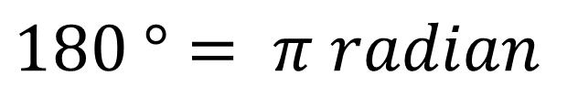
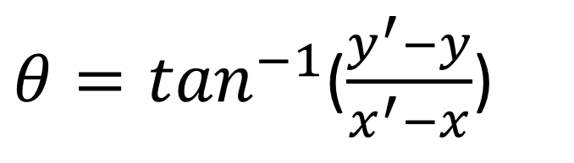
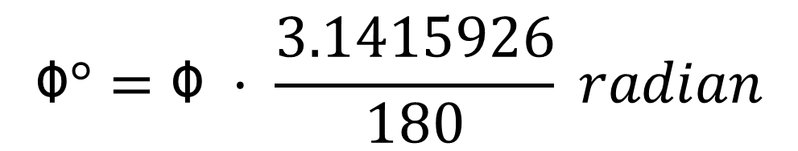
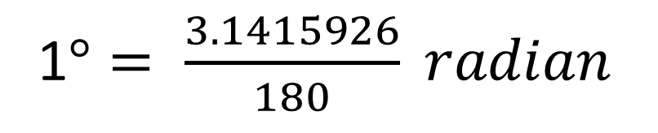
Angle Computation
p’(x’,y’)
$$180 °= π radian$$
1$°= \frac{3.1415926}{180} radian$
y’-y
θ
$$ᛰ°=ᛰ · \frac{3.1415926}{180} radian$$
x’-x
p(x,y)
${θ=tan}^{−1}$($\frac{y^{′}−y}{x^{′}−x}$)

Slide 33
#include<iostream>
#include<cstdio>
#include<cmath>
#include<algorithm>
using namespace std;
double const epx = 1e-8;
int dcmp( double x)
{
if( fabs(x) < epx)
return 0;
return x < 0 ?-1:1;
}
struct node
{
double x,y,d;
node(double a,double b):x(a),y(b){}
node(){}
};
UVa 11096 Code (1/6)

Slide 34
typedef node vec;
vec operator - ( node a,node b) // 計算向量ba (b拉到a向量)
{
return vec( a.x-b.x,a.y-b.y);
}
node point[ 110 ];
double length( node a,node b) // 計算a,b點間距離
{
vec A = a - b;
return sqrt(A.x*A.x + A.y*A.y);
}
// 向量ab向量ac 外積
double crosspruduct(node a,node b,node c)
{
vec AB = b - a;
vec AC = c - a;
return AB.x * AC.y - AB.y * AC.x ;
}
UVa 11096 Code (2/6)

Slide 35
// 座標排序
bool idcmp(node a ,node b)
{
return ( a.x == b.x )? ( a.y < b.y ): ( a.x < b.x );
}
//以p[0]為convex hull起點,與剩下的點做極角排序
bool anglecmp( node a,node b)
{
double cp = crosspruduct( point[0],a,b);
if( dcmp(cp) == 0 )
return a.d < b.d; //極角相等距離由近到遠(p[0],a與b共線)
return cp > 0; //極角排序: cp > 0時, p[0], a,b逆時針方向,表示a的極角比b極角小;
// cp<0時, p[0], a,b順時針方向,表示a的極角比b極角大
}
UVa 11096 Code (3/6)

Slide 36
UVa 11096 Code (4/6)
double graham( int n) // Graham’s scan,傳回convex hull 周長(sum)
{
if( n > 1 )
{
sort( point,point+n,idcmp); // 座標排序,p[0]為左下方點
for(int i=1; i<n; i++)
point[i].d = length(point[0],point[i]); //p[i]點與p[0]距離
sort(point+1,point+n,anglecmp); //極角排序,以p[0]為極座標原點,極角由小至大排序
}

Slide 37
UVa 11096 Code (5/6)
int top = n-1; // 暫存值
if( n > 2 ) { //graham's scan 至少3點
top = 1;
for( int i = 2;i <n ;++i) {
while( top > 0 &&crosspruduct( point[ top-1],point[top],point[i])<0) --top;
// 如果point[top-1],point[top],point[i]形成順時針,則把point[top]踢掉(--top)
point[++top] = point[i];
}
} // graham’s scan結束,convex hull頂點存在陣列point[0], point[1],.. point[top]
point[++top] = point[0]; // 封閉起來
double sum = 0.0; // 計算convex hull 周長(sum)
for(int i=0; i<top; i++)
{ sum += length( point[i],point[i+1]); }
return sum ; // 傳回convex hull 周長(sum)
}

Slide 38
int main()
{
int cas,len,num;
freopen("11096.in", "r", stdin);
freopen("11096.out", "w", stdout);
cin>>cas;
while( cas-- ) {
cin>>len>>num;
for(int i=0; i<num; i++) {
scanf("%lf %lf",&point[i].x,&point[i].y);
}
double ans = graham(num);
if( ans < len ) ans = (double)len ;
// 如果橡皮筋原始長度len大於convex hull周長(ans),則輸出原始長度
printf("%.5lf\n",ans);
}
return 0;
}
UVa 11096 Code (6/6)

